Slide 1
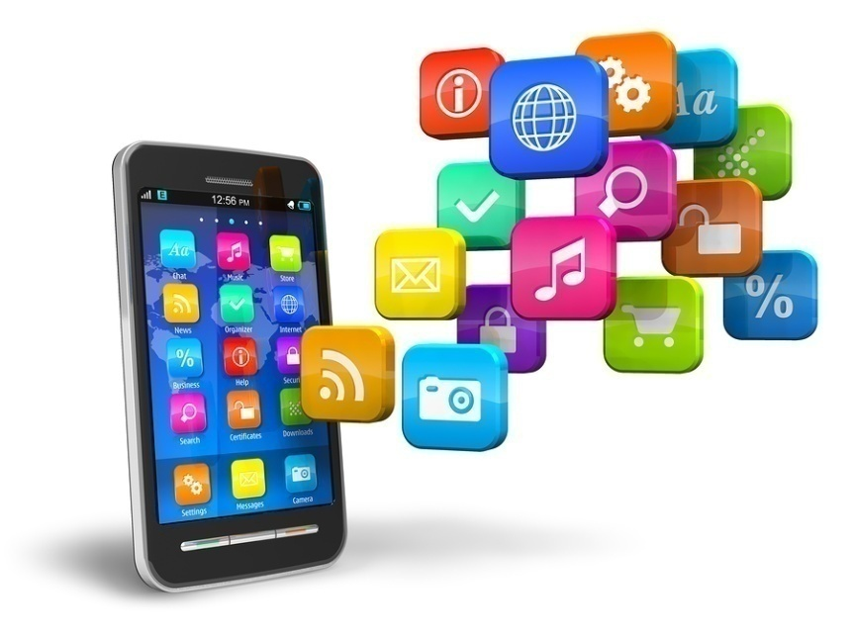
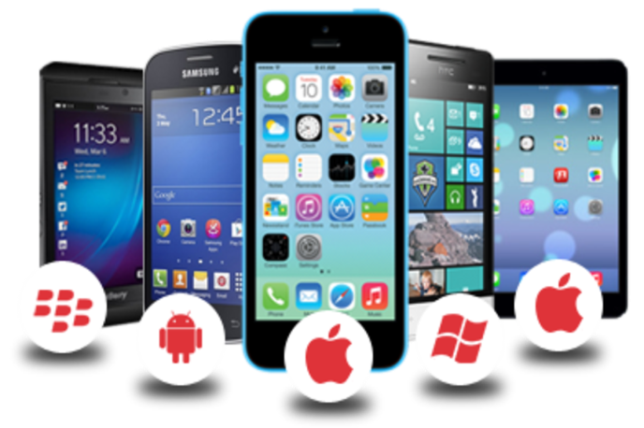
Mobile Application Development

Slide 2
Mobile Application
A mobile app is a computer program designed to run on a mobile device such as a phone/tablet or watch.
Mobile applications often stand in contrast to desktop applications that run on desktop computers, and with web applications which run in mobile web browsers rather than directly on the mobile device.
The term "app" is a shortening of the term "software application".

Slide 3
Mobile Application(contd..)
Most mobile devices are sold with several mobile apps bundled as pre-installed software, such as a web browser, email client, calendar etc.
Apps that are not preinstalled are usually available through distribution platforms called app stores.
They began appearing in 2008 and are typically operated by the owner of the mobile operating system, such as the Apple App Store, Google Play, Windows Phone Store, and BlackBerry App World. However, there are independent app stores, such as F-Droid.

Slide 4
Mobile software distribution platforms
Google Play
App Store
Microsoft Store
Amazon Appstore
BlackBerry World
Ovi (Nokia)
Samsung Apps
F-Droid
Opera Mobile Store
And many more……

Slide 5
Mobile Application Development
Mobile app development is a term used to denote the act or process by which a mobile app is developed for mobile devices, such as personal digital assistants, enterprise digital assistants or mobile phones.
Developing apps for mobile devices requires considering the constraints and features of these devices.
Mobile devices run on battery and have less powerful processors than personal computers

Slide 6
Mobile Application Development
Mobile devices have more features such as location detection and cameras.
Developers also have to consider a wide array of screen sizes, hardware specifications and configurations because of intense competition in mobile software and changes within each of the platforms
Mobile user interface (UI) design is also essential in the creation of mobile apps

Slide 7
Mobile Operating Systems
Android
Linux-based operating system created with current mobile device capabilities in mind
Can create applications that take full advantage of all the features a mobile device has to offer
Current version is Android 8.0, also known as Oreo
iOS
Designed for Apple Mobile phones and mobile devices
Current version is iOS11.2.2.

Slide 8
Mobile Operating Systems
Windows 10 Mobile
developed by Microsoft for windows smart phones
Blackberry OS
Designed for Blackberry devices
And many more……..

Slide 9
References
https://en.wikipedia.org/wiki/Mobile_app
https://en.wikipedia.org/wiki/Mobile_app_development

